Slide 1

Google Data Analytics Professional Certificate Capstone Project: Cyclistic bike-Share
Chaibat Mehdi
10/08/2022

Slide 2
A) Introduction A.1) Characters of Cyclistic A.2) Team 1) Ask 1.1) Identify the business task 1.2) Monero perspective 1.3) 3 Business question for the future marketing program 1.4) Stakeholders 1.5) Task 1.6) Objectives 1.7) Report Job 2) prepare 2.1) ROCC Check 2.2) Data Source 2.3) Data Selection 2.4) Delete useless information and combine data into 1 fille 3) process 3.1) Preparing the data 3.2) checking data 3.3) creating, adding data 4/5) analyze and Share 4.1) Some primer Statistical Calculating 4.2) Analysis 4.3) creating of graphic to visualize my data 4.4) dashboard 6) Act
Table of contente

Slide 3
For my capstone project, I chose to work on the Cyclistic bike share analysis case study. In this project, I will be performing the tasks of a junior data analyst for the marketing team at Cyclistic, which is a bike-share company in Chicago. To answer the key business questions, I will be using a structured approach consisting of the six primary data analysis steps taught in the course: Ask, Prepare, Process, Analyze, Share And Act. • Initial analysis of datasets provided by cyclistic using Power Bi. • Data cleaning, validation and exploration using Power Bi. • Documentation of code I use for Dax will be in this PowerPoint. • Data visualization using Power Bi.
Introduction

Slide 4
More than 5,800 bicycles and 600 docking stations can be found in the bike-share program Cyclistic. By further providing reclining bikes, hand tricycles, and cargo bikes, Cyclistic distinguishes itself from the competition and broadens the appeal of bike sharing to riders with impairments and others who are unable to utilize a conventional two-wheeled bike. About 8% of riders choose assistive bikes, whereas the majority ride standard bikes. Although cyclists are more likely to ride for pleasure, about 30% also use them to get to work every day.
Characters of Cyclistic:

Slide 5
Lily Moreno: - The director of marketing and your manager. - Moreno is responsible for the development of campaigns and initiatives to promote the bike-share program. Cyclistic marketing analytics team: A team of data analysts who are responsible for collecting, analyzing, and reporting data that helps guide Cyclistic marketing strategy. Cyclistic executive team: The notoriously detail-oriented executive team will decide whether to approve the recommended marketing program.
Team:

Slide 6
This phase is where we identify, define and ask the right question to solve our data problem. Identify the business task: Strategy to maximize the number of annual memberships by converting casual riders into annual riders. Monero perspective: She believes company’s future success depends on maximizing the number of annual memberships. She think rather than creating a marketing campaign targeting all new customers, there is a very good chance to convert casual riders into members. 3 Business question for the future marketing program: - How do annual members and casual riders use Cyclistic bikes differently? (Question I have to work) - Why would casual riders buy Cyclistic annual memberships? - How can Cyclistic use digital media to influence casual riders to become members? Stakeholders: Lily Moreno: The director of marketing and your manager. Cyclistic executive team: The notoriously detail-oriented executive team will decide whether to approve the recommended marketing program. Cyclistic marketing analytics team: A team of data analysts who are responsible for collecting, analyzing, and reporting data that helps guide Cyclistic marketing strategy.
Ask:

Slide 7
Task: Provide a data-driven approach to convert casual riders into annual members by analyzing the most recent (2021) 12-month Cyclistic Customer Data, in order to understand how annual members and casual riders utilize Cyclistic bikes differently. Objectives: - Organize the data to clearly spot trends about annual and casual riders. - Run a comprehensive analysis for finding the most optimized marketing strategy. - Create supporting visualizations to communicate the data. Report Job: - A clear statement of the business task - A description of all data sources used - Documentation of any cleaning or manipulation of data - A summary of your analysis - Supporting visualizations and key findings - Your top three recommendations based on your analysis
Ask:

Slide 8
In the prepare phase, we analyze the quality (ROCC) of the data and the limitations it has. Data Source: - Data is contained in a public dataset which can be found at: https://divvy-tripdata.s3.amazonaws.com/index.html. - Data is provided by Motivate International Inc. under this license agreement. - Data was collected by the customers activity on Cyclistic but customers were kept anonymous they all were issued a unique ID. - I are using the 2021 data since it is the most recent 12 month data available on the data set. ROCC Check: - Reliable: High, the data has a very large size ( about 5 million rows on the trip_id column.) - Original: Low, the data is provided by a third-party called Motivate International Inc. - Comprehensive: High, the data has more traits than needed for this analysis. - Current: the data is 1 years old it is not the most up to date data but it isn’t outdated either. - Cited: Low, the data is collected from a third-party.
Prepare:

Slide 9
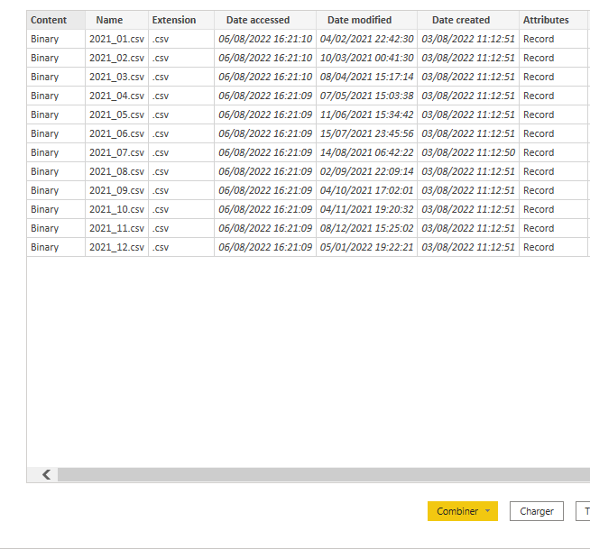
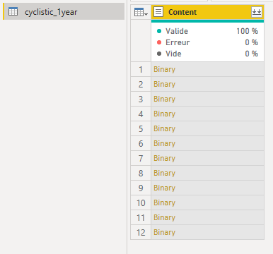
Data Selection:
Prepare:
Tool:
Power Bi
Power Query
Delete useless information and combine data into 1 fille:

Slide 10
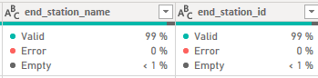
This is the phase where the data is cleaned and transformed to be ready for analysis. Preparing the data: 1) checking data: - Combined the 12 files into one power bi file(in power query). - Then i try to find if my data have empty row or error by using function (column quality). - I find that the column end_station_name and end_station_id have 1% of empty row and no error. - Then i remove all empty row. - I check if columns have incorrect orthography. - I check individual columns for the assigned data type.
Process:

Slide 11
2) creating, adding data: - Create a column named “ride_length” (select: ended_at - started_at) go (function: add columns/time/subtract). • which calculates the time period length of each ride, and I do (function: transform/duration/total min) to transform time into min. • After inspecting the columns, i find that it has negative value. • I delete all negative value (after investigate what cause is) and filter the columns, greater or equal to 00:01:00. - I Create another column named “Day_of_week” to calculate the day of the week (i add +1, cause by default it starts at 0 to 6). - I add 3 columns for further analysis (months/start_time/4season). I close power query to start analyses and visualization step.
Process:

Slide 12
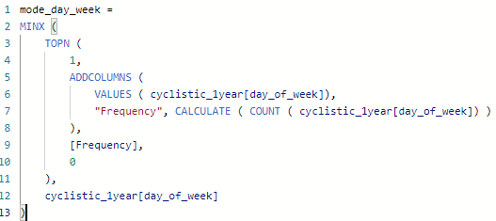
at this phase I need to draw some conclusions based on the reliable facts and share my findings after getting different views. 1) Some primer Statistical Calculating: - Calculation of the mean, median, maximum value and Total value of the Ride_length columns in min. - Calculation of the mode of Day_of_week - Dax Code i use for mode calculation : (power bi don’t have how to calculate mode integrate like mean or median) - I made some calculation for the others columns to have better understanding of my data.
Analyze and share:

Slide 13
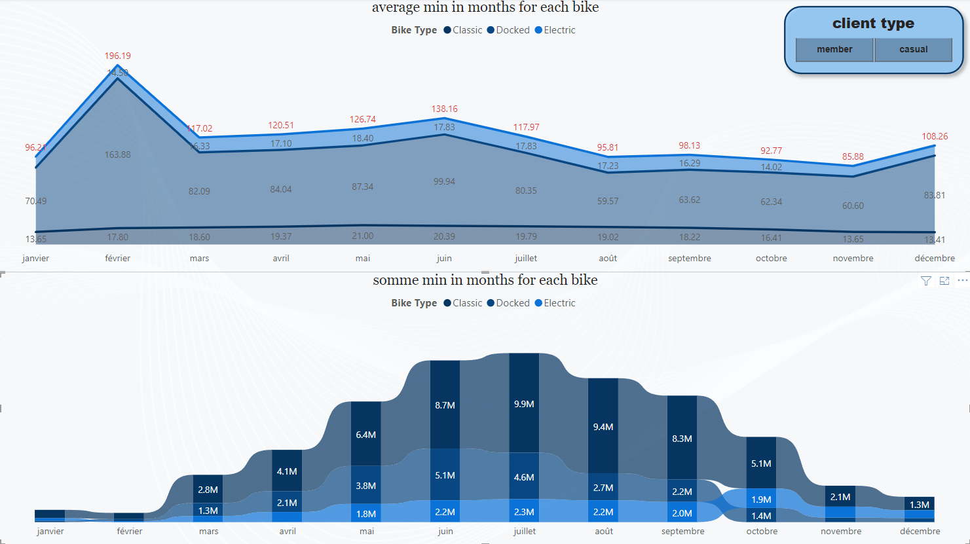
2) Analysis: 2.1) creating of graphic to visualize my data : - I use 2 Area Charts to have good idea of the average ride time for the 3 bike by each days and months for member vs casual users.
Analyze and share:

Slide 14
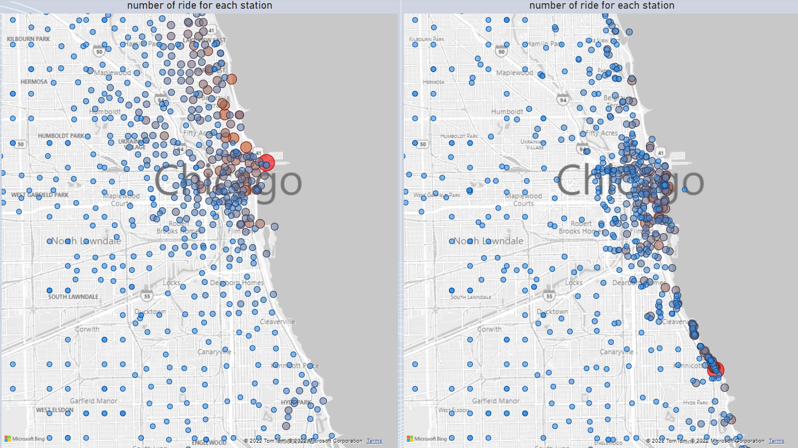
- I use map charts to see with station are the more used for starting and end of the customer.
Analyze and share :

Slide 15
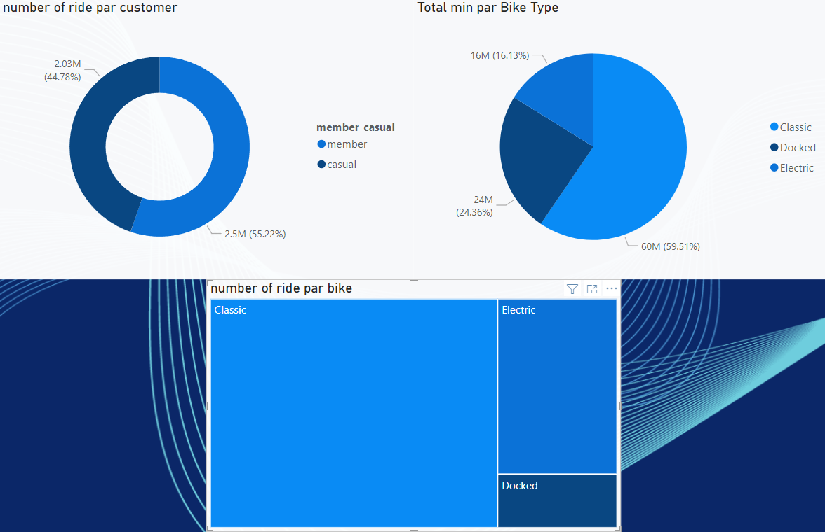
- I use Doughnut Charts, Pie Charts and Treemap to see how many annual /casual customer we have, and witch bike are the most used par customer in total min plus number of ride for 2021. - finally I create dashboard to have perfect idea of my data.
Analyze and share :

Slide 16
2.2) dashboard: - I created 5 dashboards with different colors. - The first one (Ahem) is the first dashboard I ever created. - The second one (blue) is my favorite because I chose the color scheme myself and I love the color blue.☺. - the last one have color that match the logo.
Analyze and share :

Slide 17
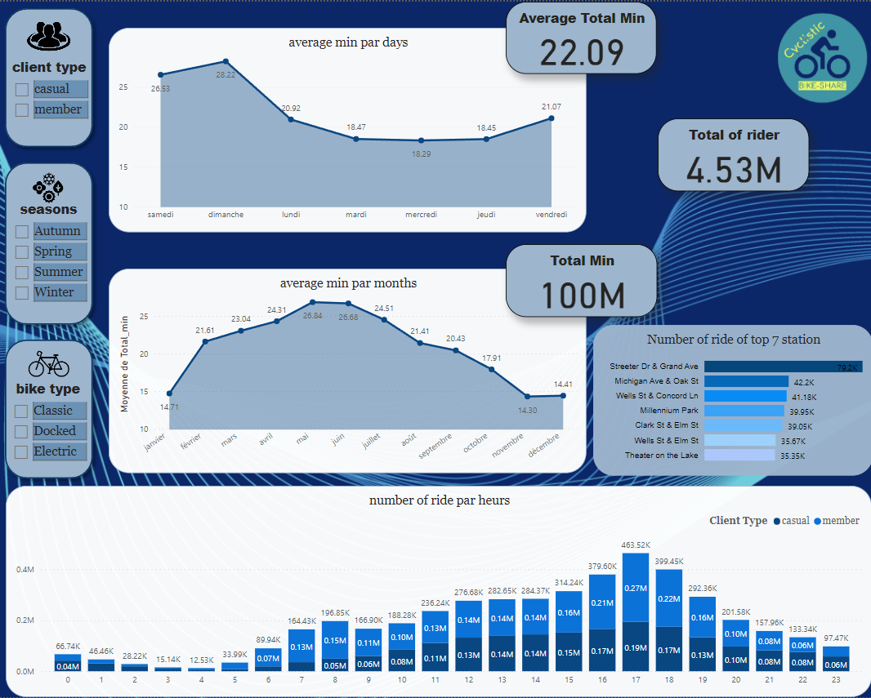

Slide 18
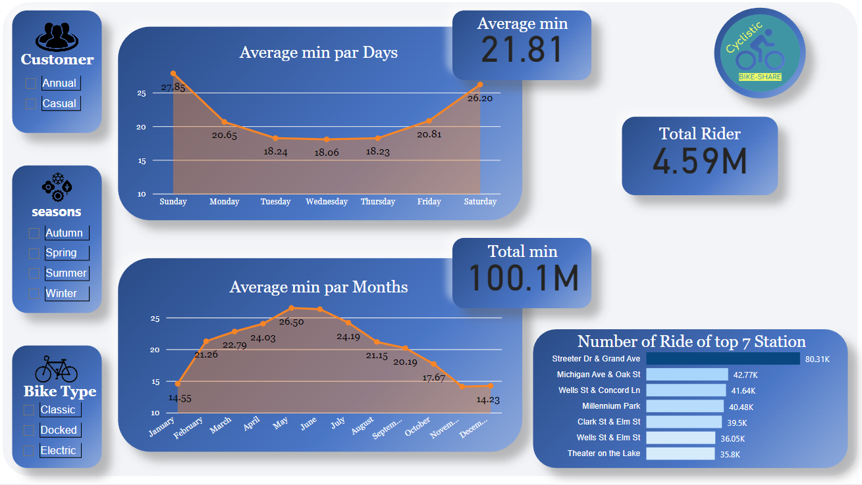

Slide 19
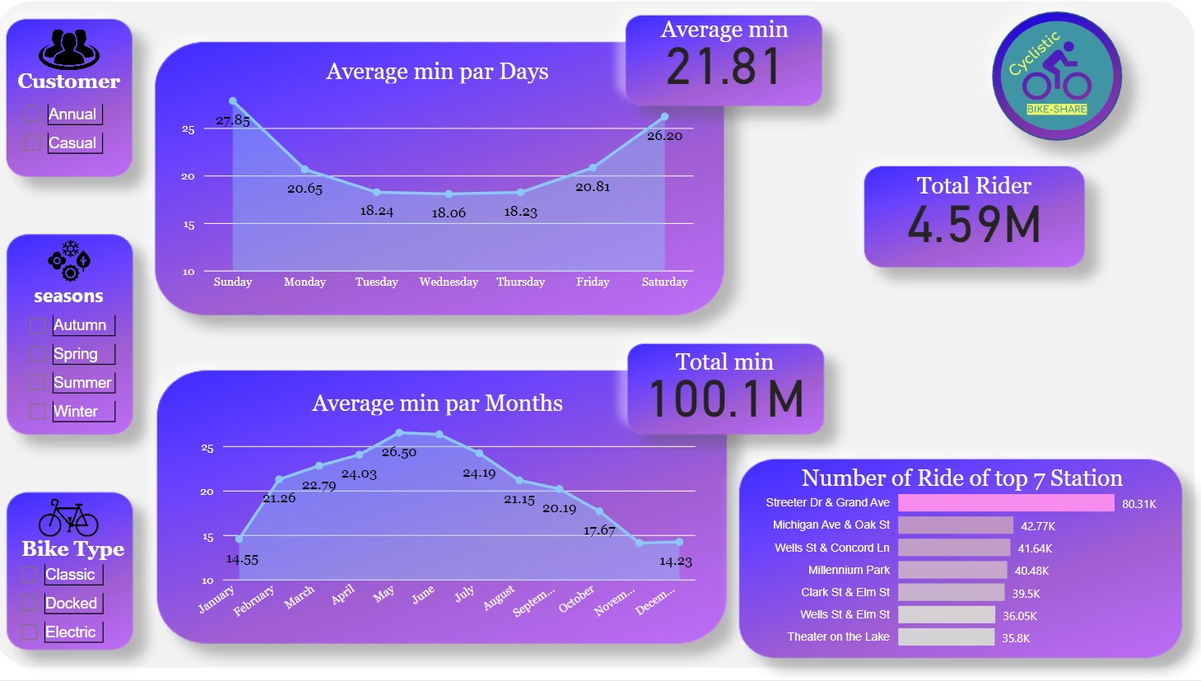

Slide 20
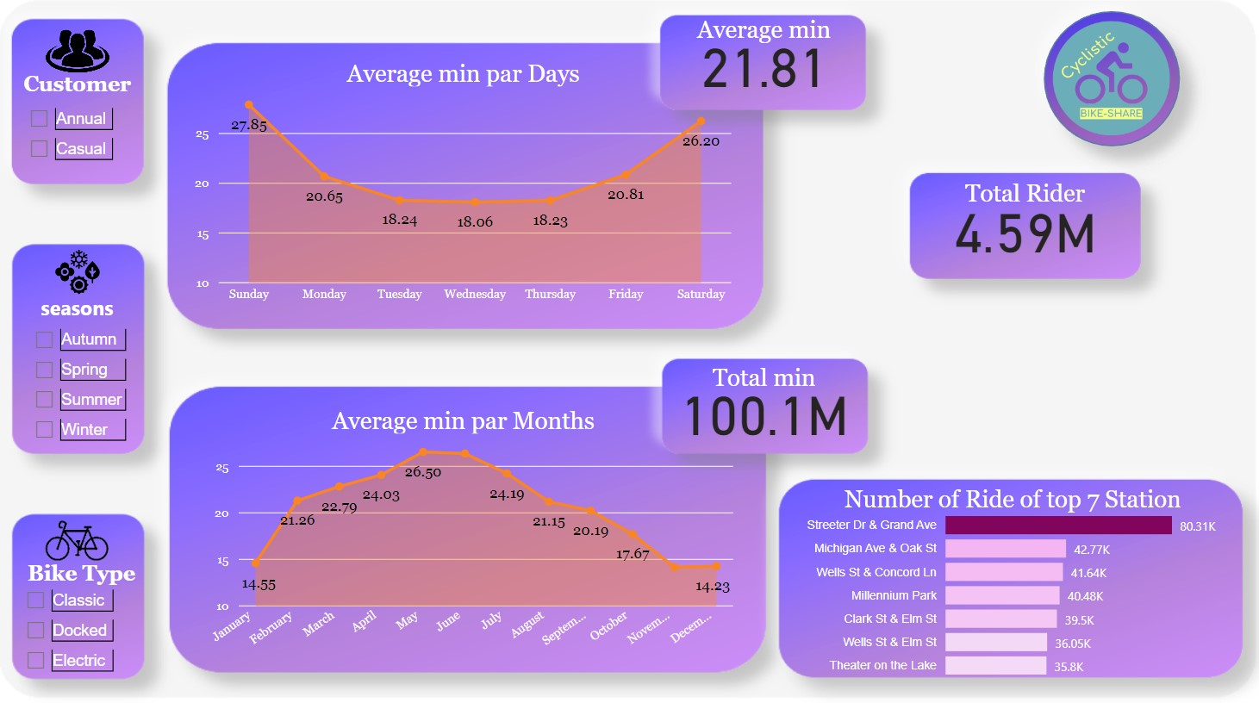

Slide 21
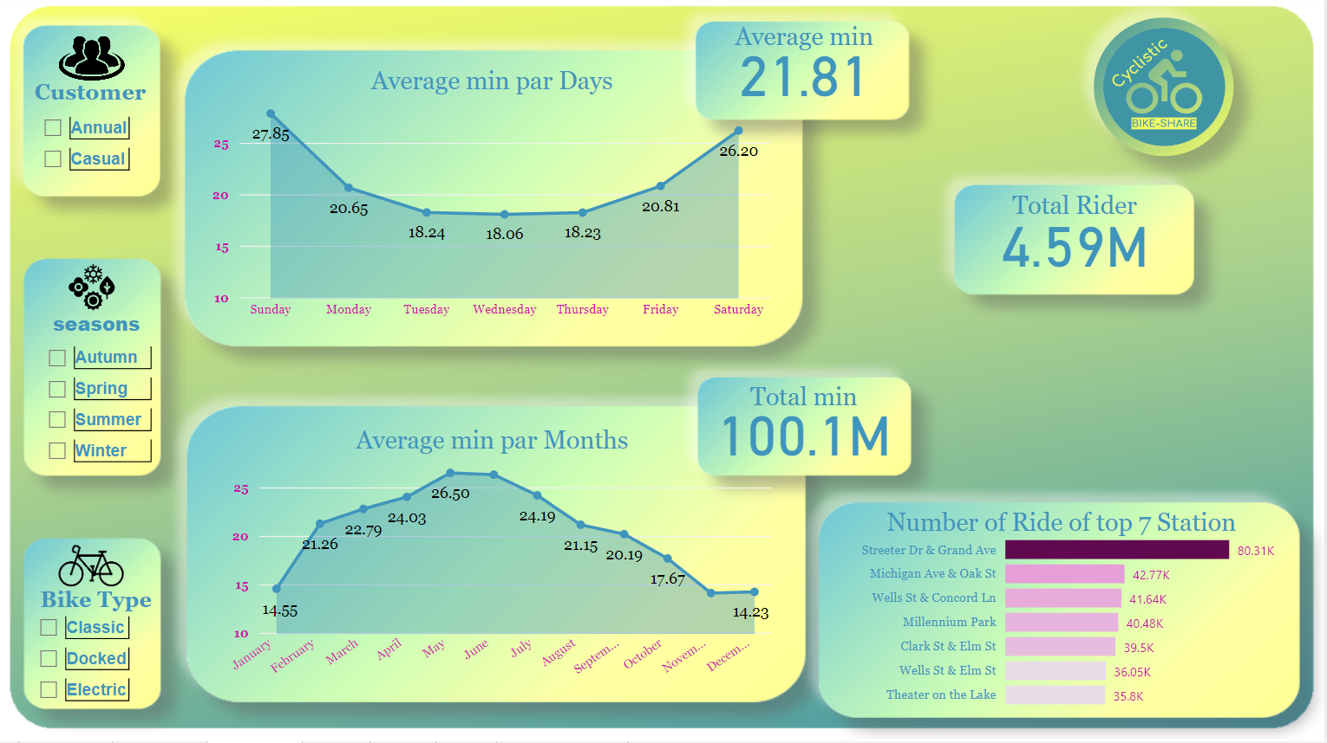

Slide 22
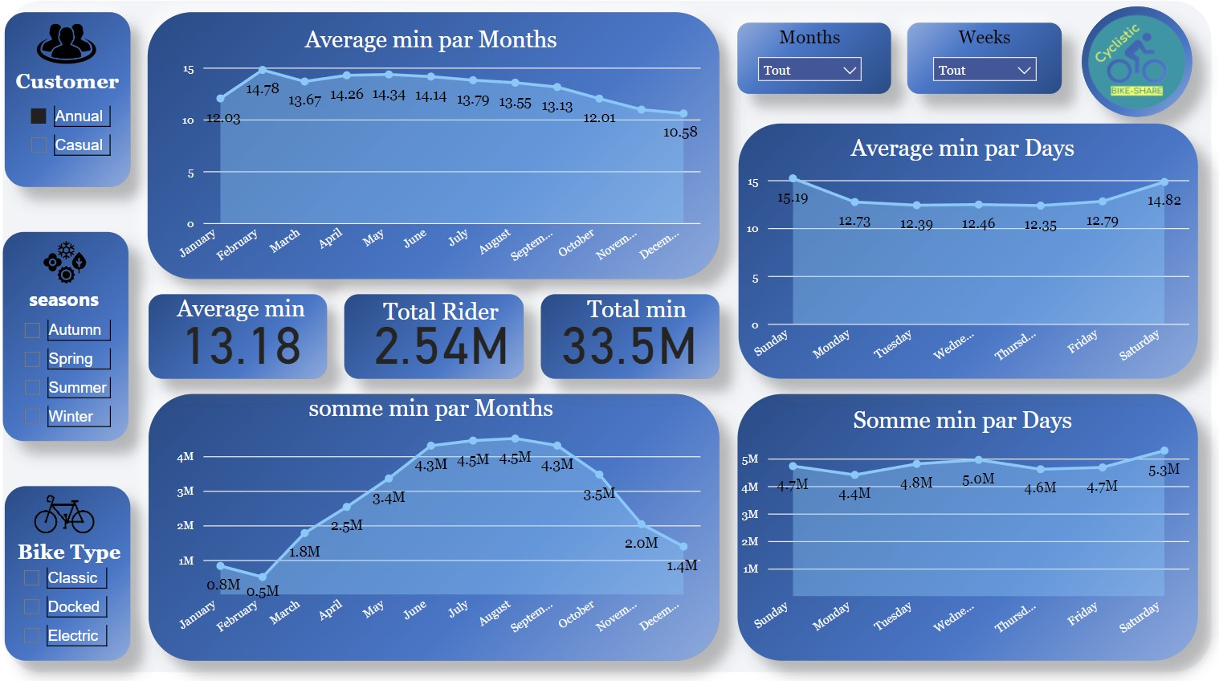
Average and Sum for Annual Customer in months, days:

Slide 23
1) charts Analyze : - The first graph shows that there are discrepancies between the average and sum for some months. For example, although the average rating for February is the highest, the sum of ratings for that month is the lowest among all the months in 2021. - The days chart demonstrates that Sunday and Saturday have higher average ratings than the other days, and the fluctuations in ratings are less than those in the Sum chart.
Annual Customer:

Slide 24
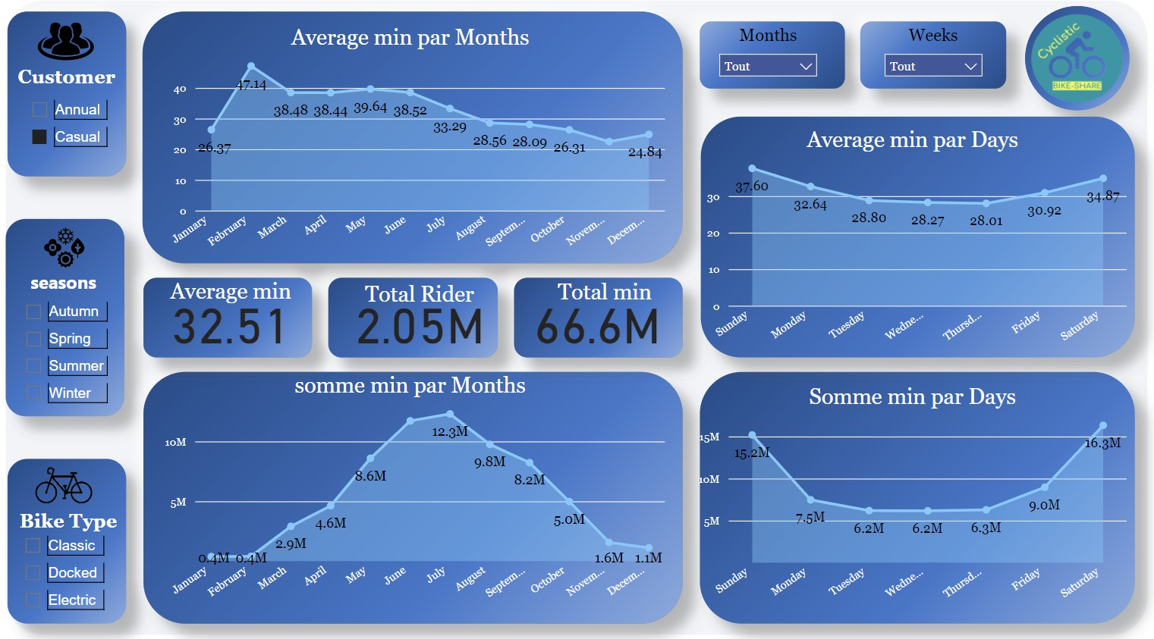
Average and Somme for Casual Customer in months, days:

Slide 25
3.1) charts Analyze : - The first graph shows that the average and total for some months do not match. For example, in February, the average is highest but the total is lowest across all of 2021, similar to the trend observed for annual customers. - The chart for days of the week reveals that Sunday and Saturday have higher average ratings compared to the other days. This trend is also observed in the chart for the total number of rides. However, there is more fluctuation in the charts for other metrics.
Casual Customer:

Slide 26
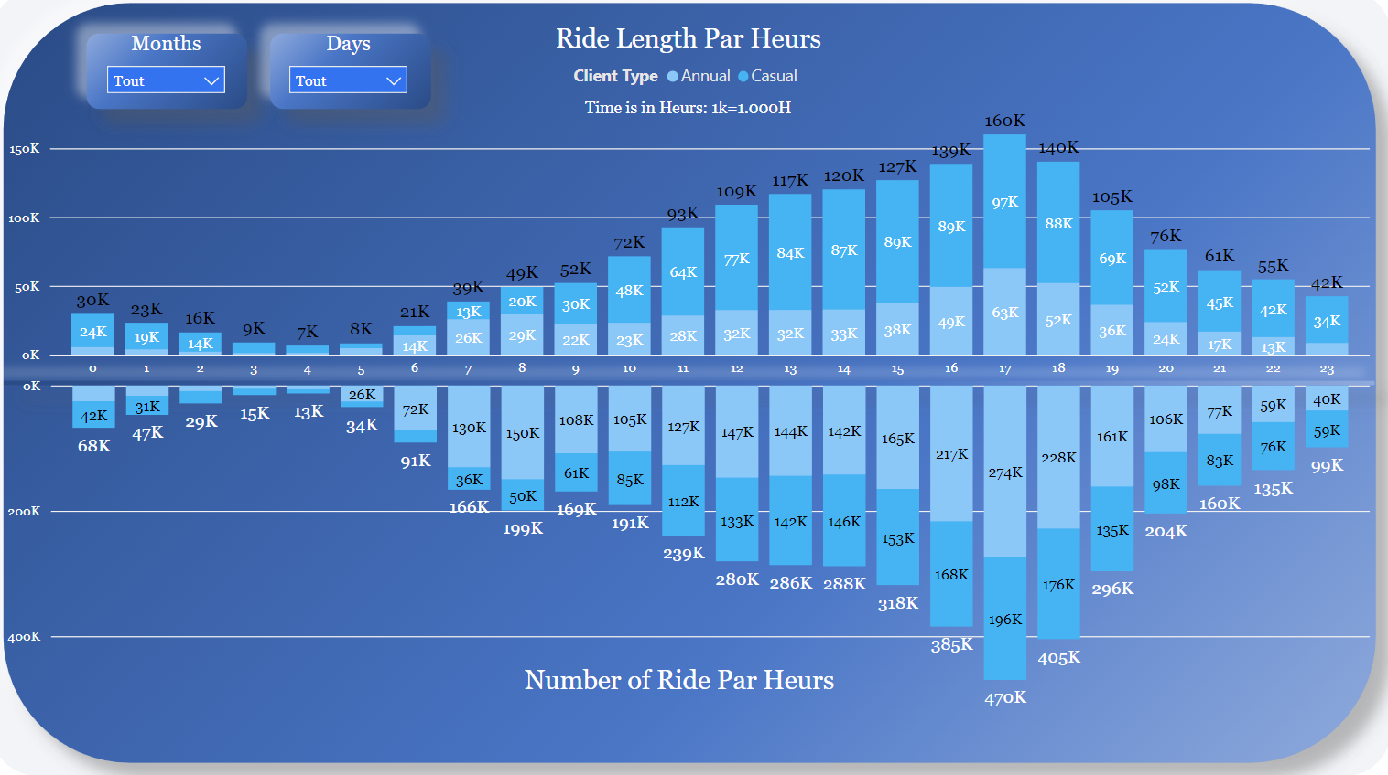

Slide 27
3.1) charts Analyze : - This chart shows that the peak hours for bike rides are between 4:00 PM to 6:00 PM, with the highest number of rides and longest ride durations during this time. - This suggests that this time period is the most popular for using our service. - On the other hand, the chart also indicates that 3:00 AM and 4:00 AM are the least popular times for using our service, with very low numbers of rides during these hours.
Annual Customer:

Slide 28
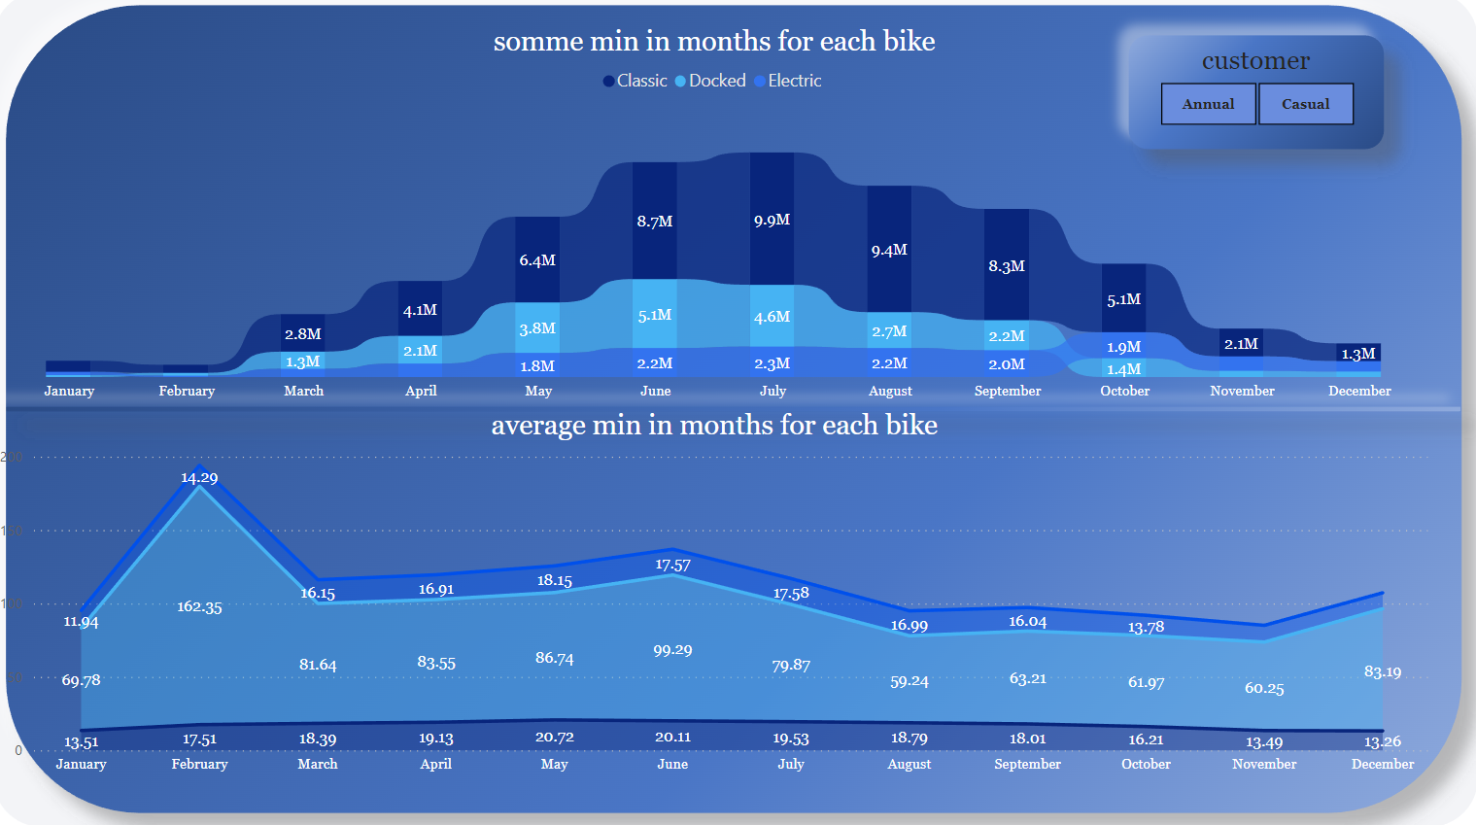

Slide 29
3.1) charts Analyze: - The first chart indicates that, overall, classic bikes have been the most utilized bike type this year, followed by docked bikes from January to September. - The second chart shows that, on average, docked bikes are by far the most popular, with usage rates more than three times those of other bike types.
Annual Customer:

Slide 30
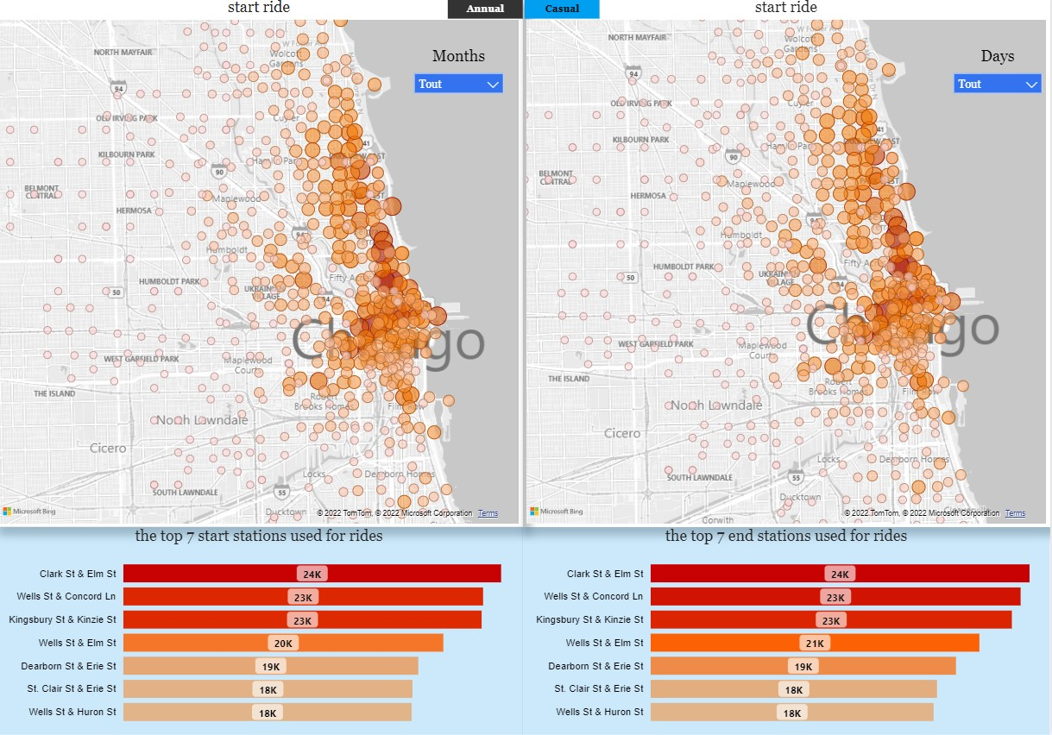
Annual Customer:

Slide 31
3.1) charts Analyze: - The chart indicates that, the majority of ride start and end locations are within close proximity to the lake's coast.
Annual Customer:

Slide 32
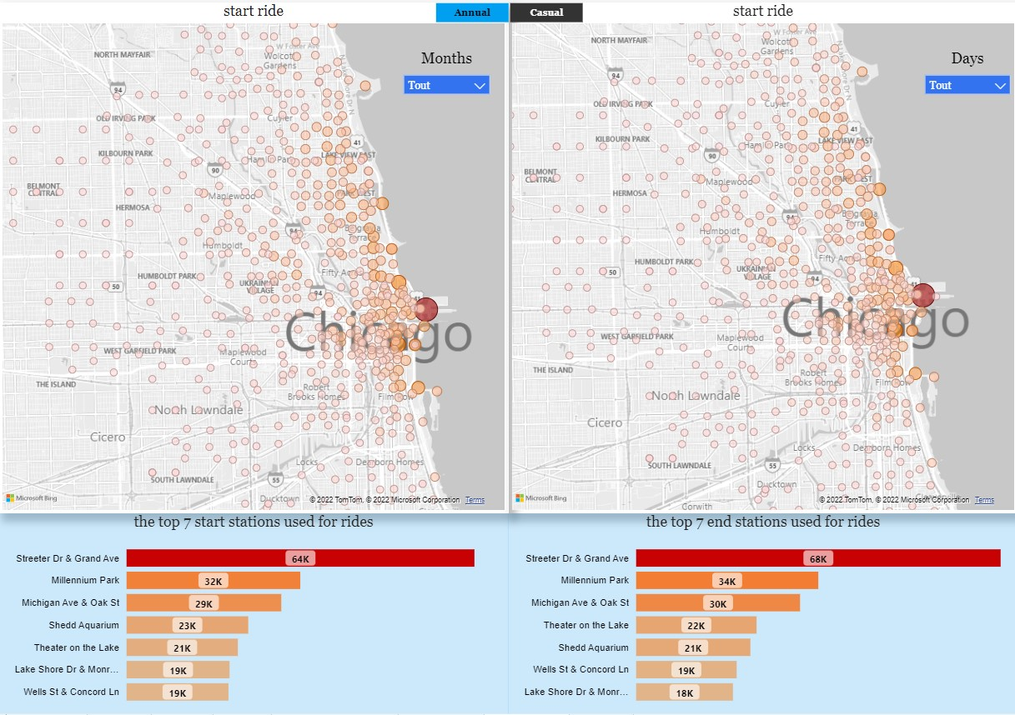
Casual Customer:

Slide 33
3.1) charts Analyze: - The chart indicates that, in comparison to the chart for annual riders, the trips to the respective bike stations are more dispersed rather than concentrated at a few stations close to the lake. - However, stations close to the lake remain the most popular spots for rides.
Casual Customer:

Slide 34
at this phase we will attempt to address the issue raised by the query in this clause and present our findings (data-driven decision). Summary: 1.1) some discovery: - We found that 55% (2.5 million) of our riders are casual riders, while 45% (2.3 million) are annual riders, representing a 5% difference between the two. Casual riders utilize the bikes more in terms of time, with 71% on average, 66% in total, and 97% riding duration in 2021, but they take 10% fewer rides than annual riders. - When examining the times that people accessed our service throughout the day, week, and month, we found that: Days: The most used times are 16:00, 17:00, and 18:00, while the least used times are 03:00 and 04:00. Week: The most used days are Sunday and Saturday (weekends), while the least used days are Tuesday and Wednesday. months : The most used months are June and July (the summer season) while the least used months are January and February (the winter season)
Act:

Slide 35
1.1) some discovery: - Annual clients have an average ride duration of 13.18 minutes and a total of 33.5 million minutes ridden over all the years analyzed, while casual clients have an average ride duration of 32.51 minutes and a total of 66.6 million minutes ridden. - We observed that the curve of the total ride duration for annual clients remains relatively stable throughout the week, while for casual clients, there is a significant spike in ride duration, up to two times greater, on weekends. - We discovered that the most commonly used bike type for both client categories is the classic bike. - Looking at the map chart, we found that while there are differences in the distribution of casual and annual customers, most customers are concentrated around the lake area and the downtown core of Chicago.
Act:

Slide 36
1.2) answer for: How do annual members and casual riders use Cyclistic bikes differently? - Casual riders use the bikes for longer periods of time on average and in total, but take fewer rides compared to annual members. - Casual riders tend to use the bikes more on weekends, with ride times that can be twice as long as during weekdays. Annual members' ride times are generally more consistent throughout the week. - One possible explanation for this is that casual riders may have more free time on weekends to engage in leisure activities, while annual members may be using the bikes more for regular commuting to work or school - Annual members are more likely to be concentrated around the Lake area and downtown Chicago, while casual riders are more spread out throughout the city.
Act:

Slide 37
- For casual clients, the highest number of rides occur in June and July, which are only 2 months, but for annual clients, the highest number of rides occur in June, July, August, and September, which are 4 months. - This seasonal fluctuation could be due to weather conditions. For instance, when it's cold outside, we tend to have fewer clients, and the opposite is true when the weather gets warmer. - Since Chicago received 30.7 million visitors in 2021, there is a high probability that some of our clients are tourists or families enjoying a day at the beach. - Annual clients tend to use classic bikes more frequently throughout the year with higher scores. For casual clients, the same applies except for two things: docked bikes are the most used in April and May, and docked bikes have the highest average time.
Act:

Slide 38
1.3) Recommendations: To increasing the number of rider membership by converting casual riders into annual members : - It is difficult to give a very sharp recommendation since we don't have all the data or well-detailed information, such as how the casual clients became annual members. However, we can make some speculations based on the facts we have. - More than half of the riders are already members, indicating that the company has already sustained some level of loyalty among its bike users. Therefore, the company has a chance to convert more casual riders into members. - Since we know weekends, summer days, and holidays are the best days to ride, we can ask the marketing team to target these days, especially during the spring and summer months. - Since casual riders use our service a lot over time, we can offer subscription reductions on longer journeys, or set up a point system where the more you use our service, the more points you will have. At the end of the month or year, these points can be exchanged for a gift or more days with our service.
Act:

Slide 39
- Propose an application that tracks and displays the number of calories burned or money saved by using our service instead of conventional means of transport at the end of every month and year. - Loyalty program: Implement a loyalty program for casual riders that offers incentives for frequent use, such as discounts or exclusive offers. This will encourage them to use the service more frequently and increase the likelihood of them becoming annual members. - Offer new subscribers a free month to incentivize them to try out our service and potentially become long-term customers. - Develop microtargeted offers that are customized and delivered to specific segments of our consumer base, to maximize the effectiveness of our promotions. - Integrate gaming elements into our brand strategy to make our service more engaging and enjoyable for customers, thereby increasing customer loyalty and satisfaction.
Act:

Slide 40
Stupid Recommendations: 😊 - We could collaborate with a health food company and provide discounts to new customers based on the duration of bike usage or the number of calories burned. This could position us as a company that values the health and wellbeing of our customers. 😊 -We could emphasize the environmental benefits of using bikes, such as reducing global warming and preserving nature. This could appeal to environmentally conscious individuals and help establish us as an eco-friendly company. 😊 - Another option is to highlight the safety and reduced stress on animals compared to cars, which could attract animal lovers and position us as an animal-friendly company. 😊 - Targeting the most visited locations such as metro stations, airports or popular tourist spots could help us reach a wider audience and increase brand awareness. 😊
Act:

Slide 41
thanks:
Thanks for Reading:
credits:
I want to express my gratitude to the Google Data Analytics Coursera team for their meticulous planning, efficient delivery, and providing me with the opportunity to participate in the project. Additionally, I would like to extend my appreciation to the Power BI and Dax community for the plethora of great documentation across various forums, which aided me in selecting the right tools and functions. Lastly, I would like to thank all the creators on YouTube whose videos assisted me in the preparation, processing, and analysis phases.

Slide 42
If you need any further details, please contact me at:
LinkedIn: www.linkedin.com/in/chaibat-mehdi-data-analyst
Email: chaibat-mehdi@outlook.com
Portfolio : https://c-mehdi.netlify.app/

